Slide 1
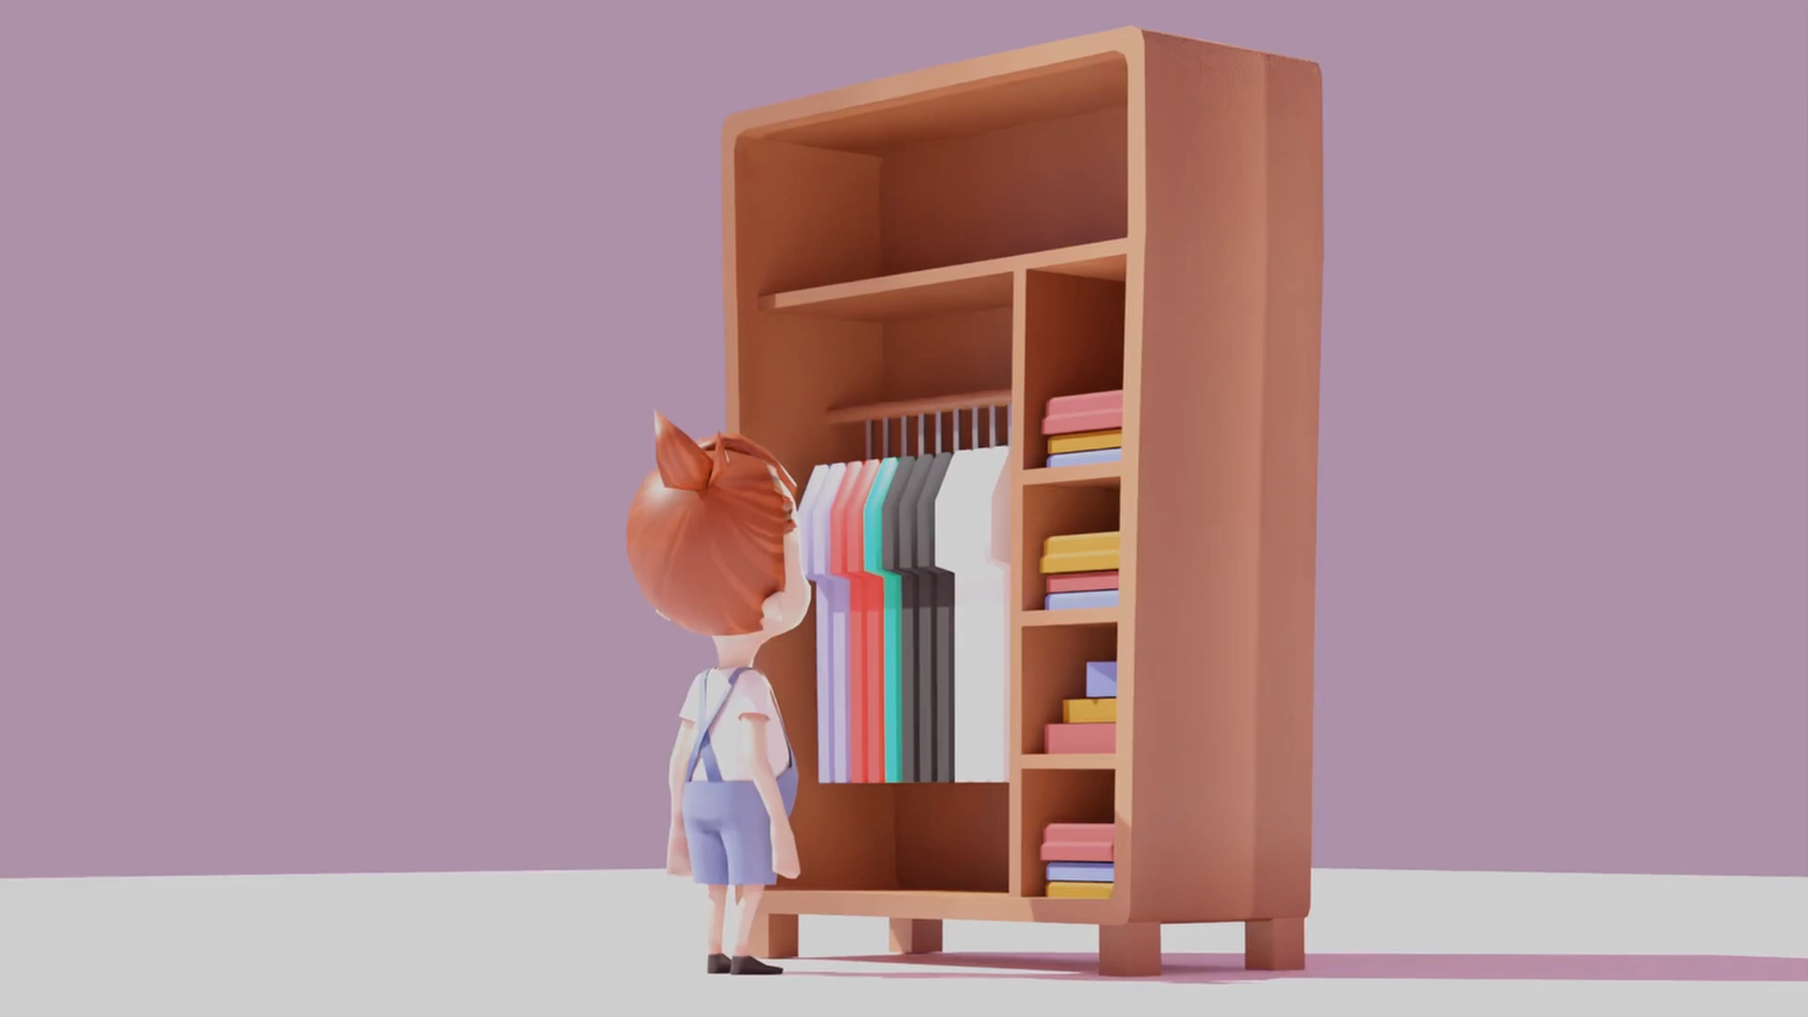

Slide 2


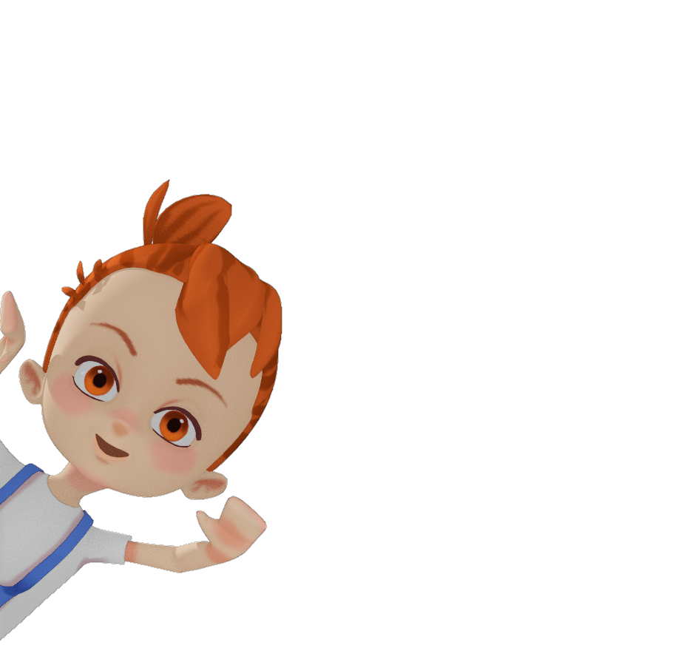
Hakon Wind
Vision Keeper, Tech Artist
Anastasia Schleicher
Production Manager, Game Designer
Zoey Goldschmidt
Character Artist, Animator
Lukas Salewsky
Programmer

Slide 3
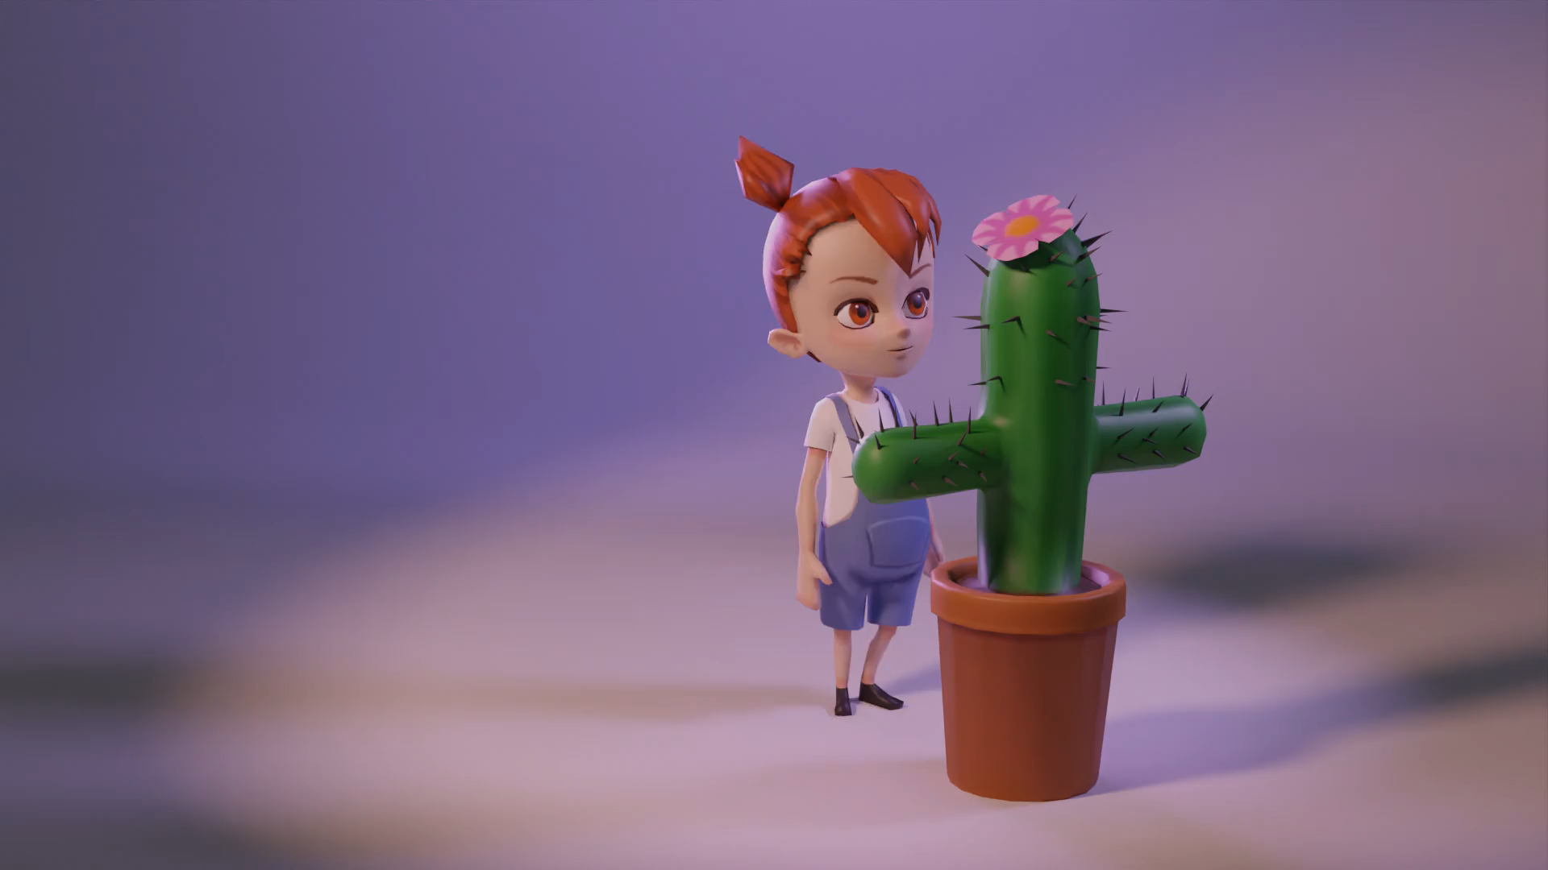
The Vision:

Slide 4
Concept
One screen one set

Slide 5


Concept
One screen one set

Slide 6
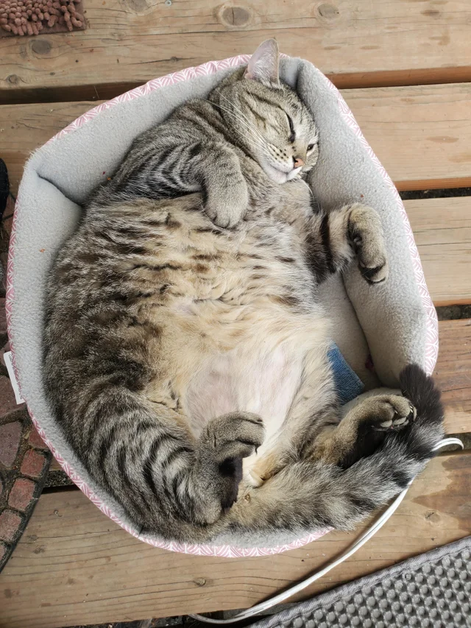
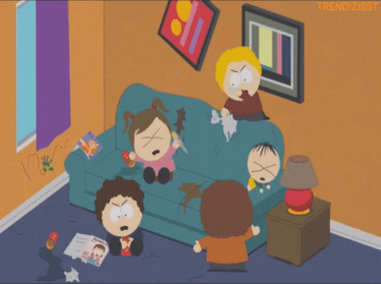
Concept
One screen one set

Slide 7

Concept
One screen one set

Slide 8

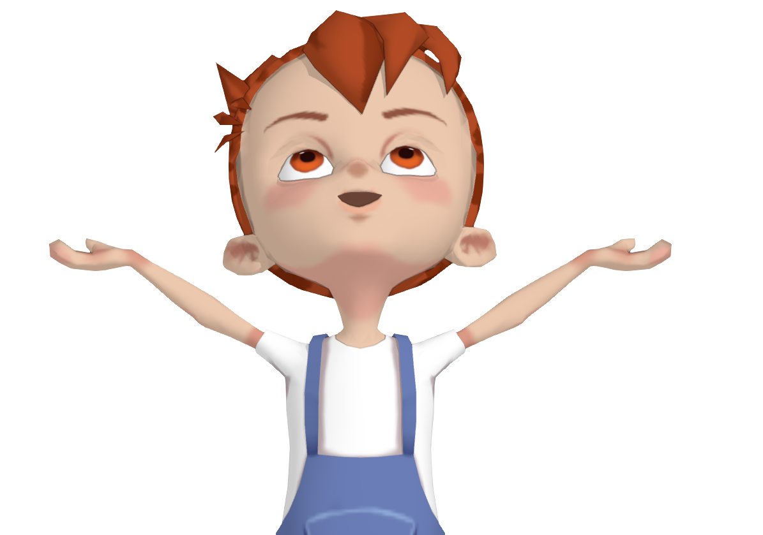
Coming up:
live demo...

Slide 9


Slide 10





Core Game Loop
prepare room
move neutral objects
tape interactable objects
reward
protect children
get rating
use cookies
earn cookies
stop interactions

Slide 11
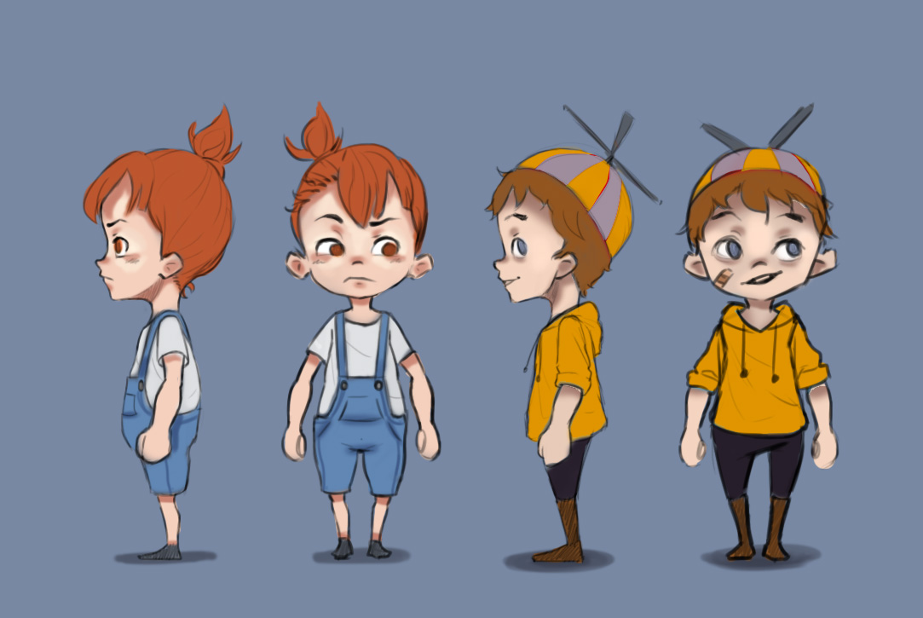
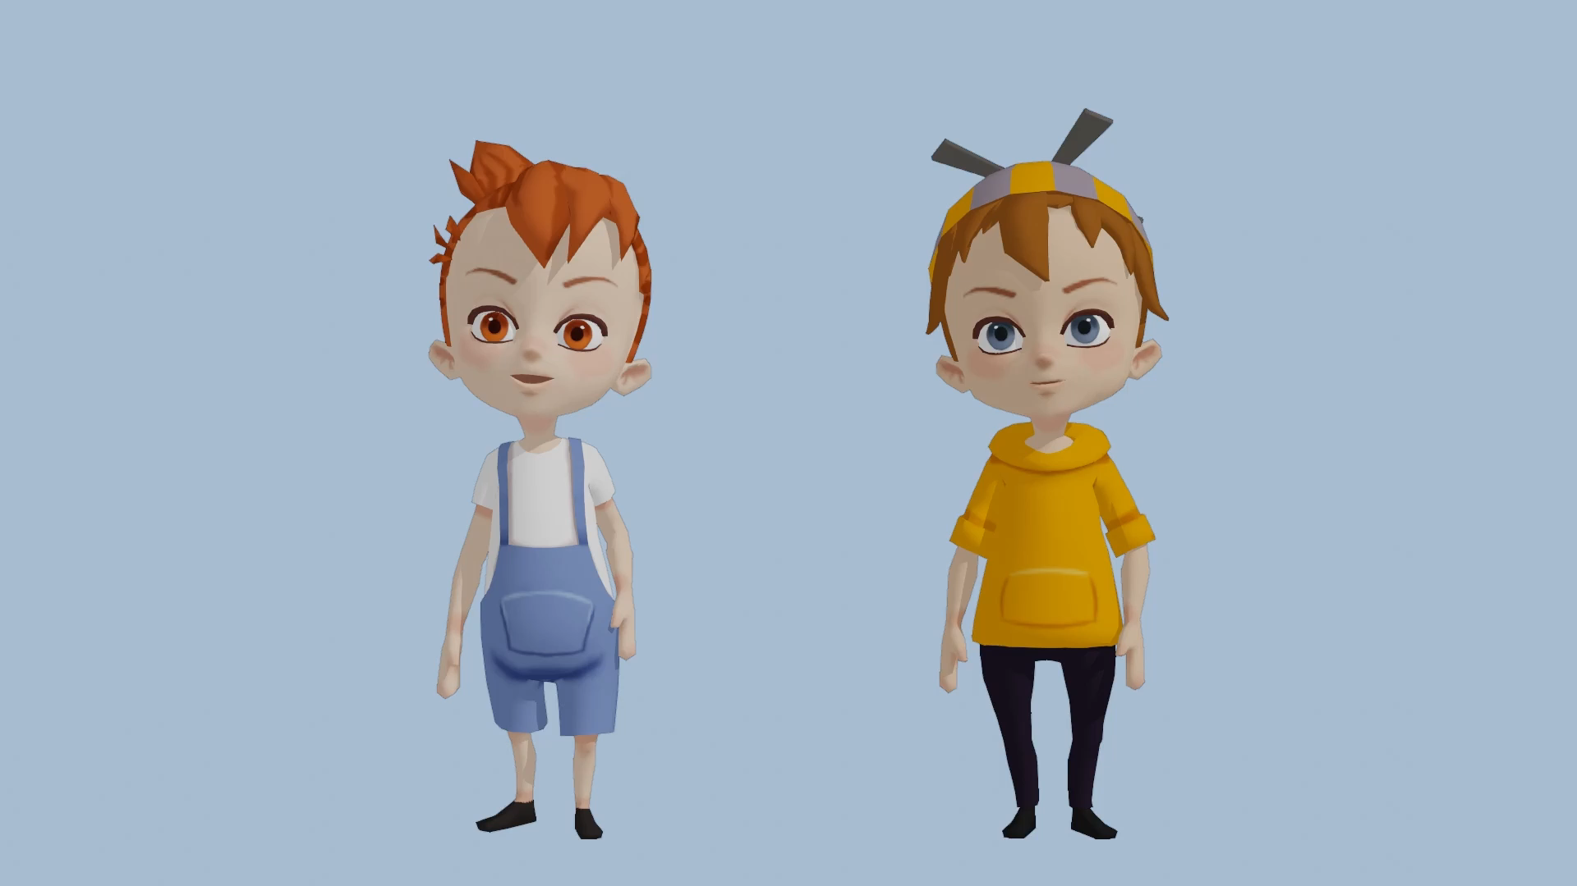
Characters

Slide 12
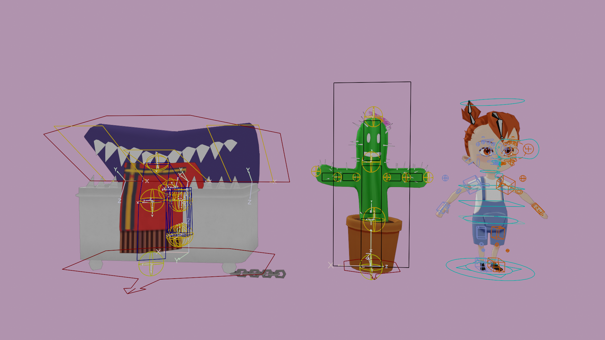
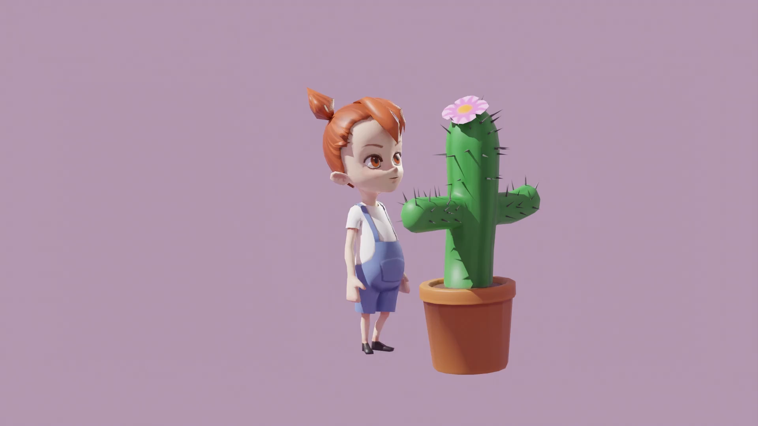
Character Animations
Rigging Reusable Animation

Slide 13
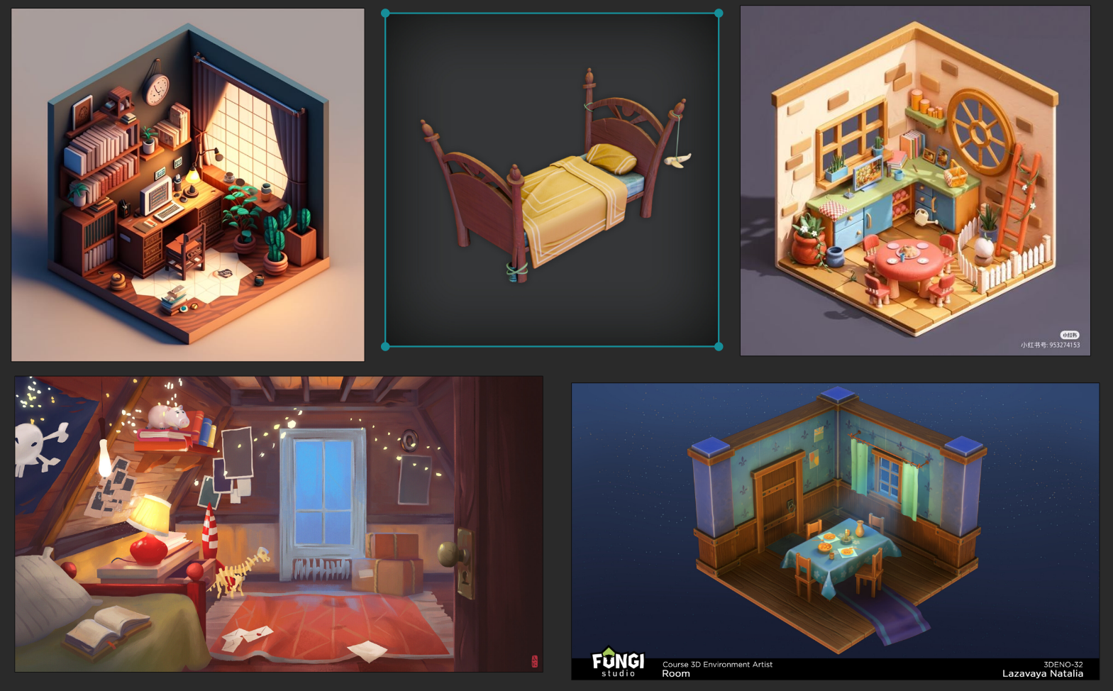
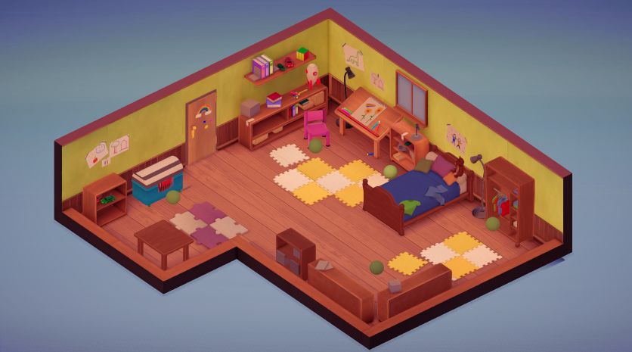

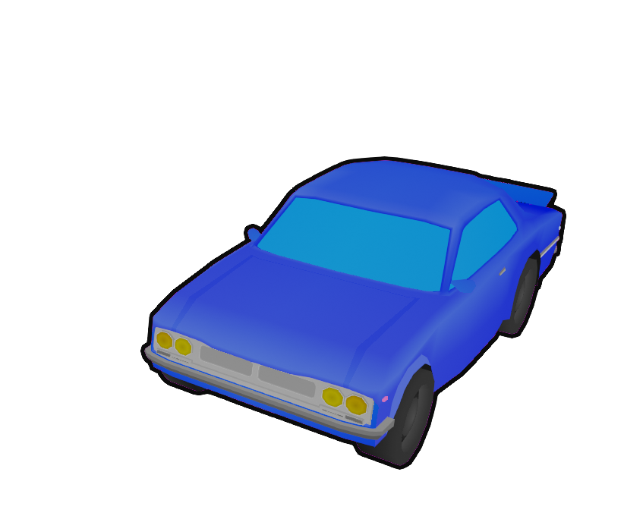
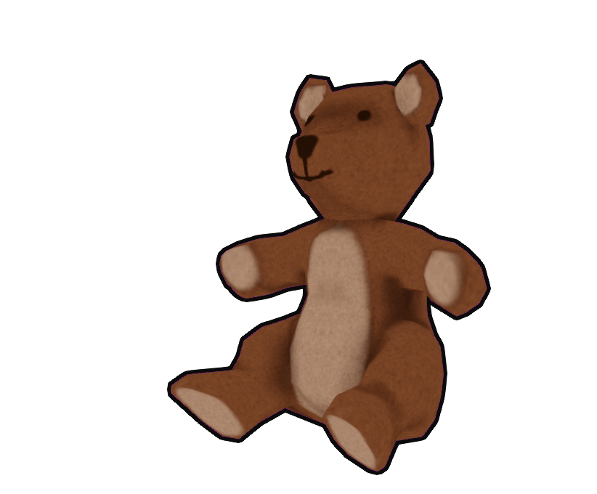
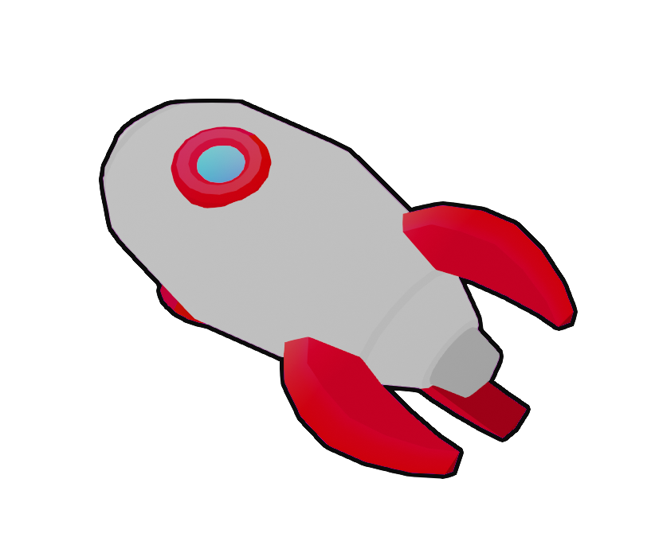
Environment

Slide 14
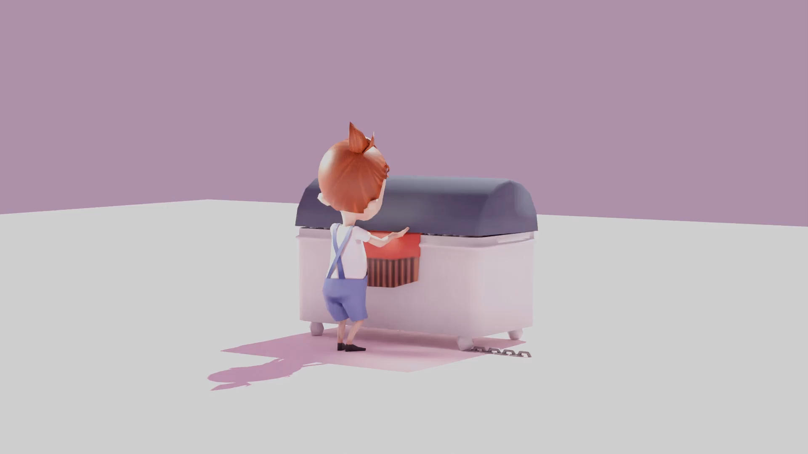

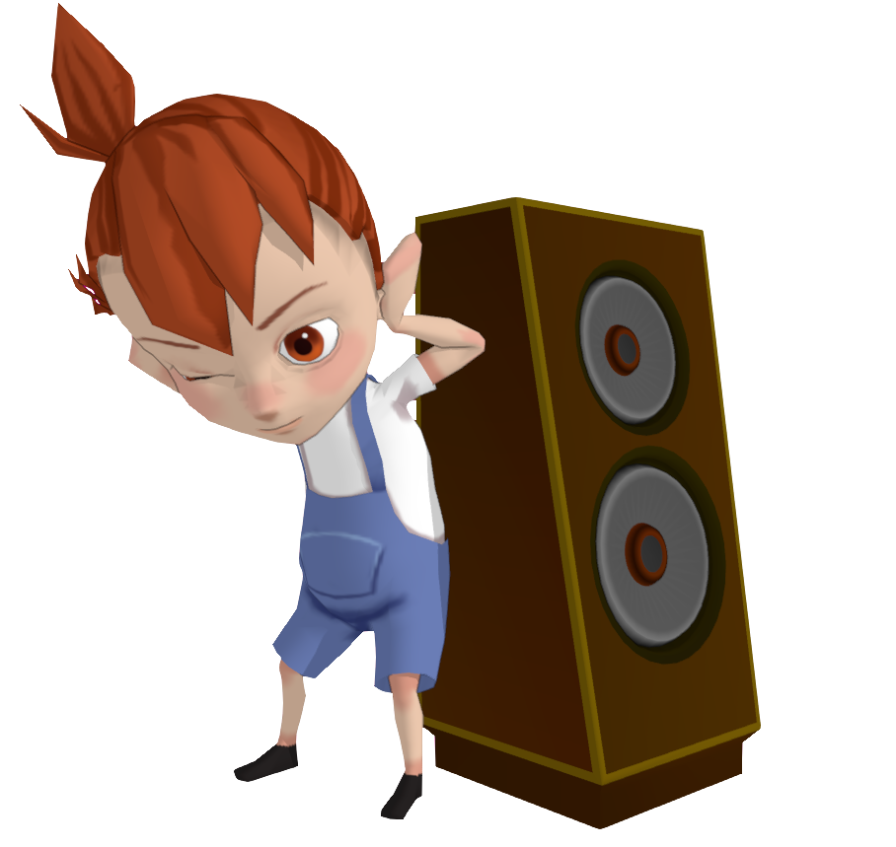
Sounds
Music
Wardrobe
Tape

Slide 15
Defining Dates
08.06.:
3 playable levels for user testing
22.06.:
Included first sound and animations
29.06.:
5 playable levels with polished mechanics
11.07.:
Finished game atmosphere!

Slide 16
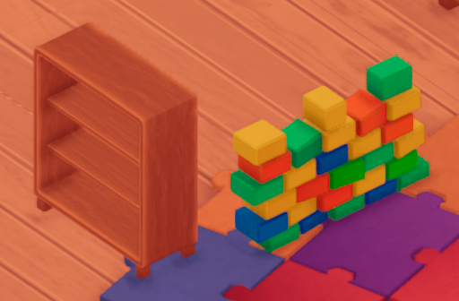
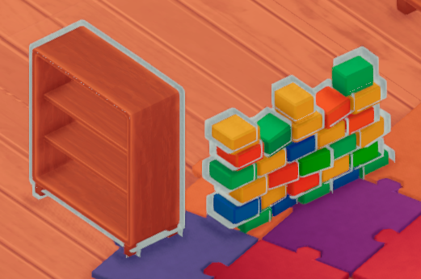
User Testing
adjusted mechanics
Carried out every 2-3 weeks until end of June
improved user feedback
explored new aspects of fun

Slide 17
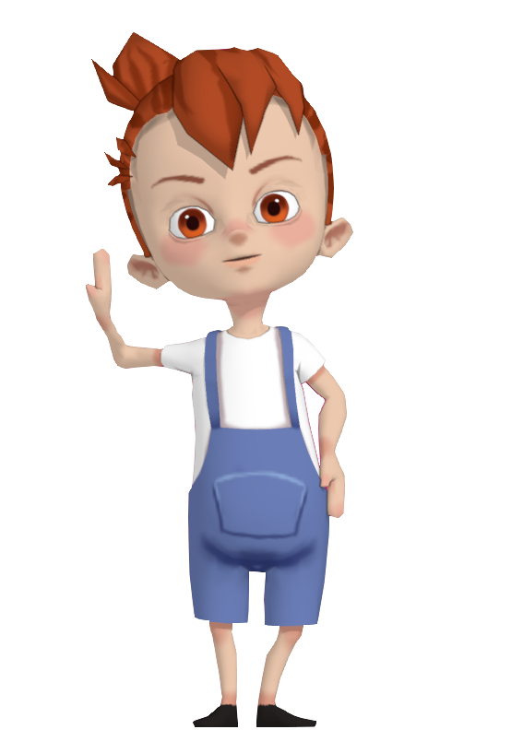
Available soon
on itch.io!

